Slide 1
Mongo AppData Toolkit Architecture

Slide 2

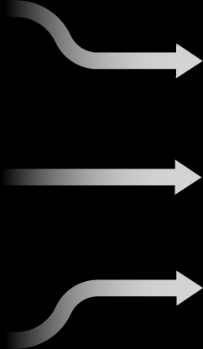

Proposed Architecture – Mongo Leveraging Standby Replication Technology
Production
Non - Production
3-node Replica Set
Node2
Automated ingestion using toolkit
Automated provisioning using toolkit
Node1
Non voting replica set node. Priority is set to zero so it never becomes a primary.
VMWare
Node3
Mongo Replica sets are typically distributed across servers and even cloud zones as a DR strategy in the case a server or even a zone goes down.
…
Data
Scientist
…
Analyst
Analyst
Analyst
Analyst
Dev 1
Dev 2
Tester 1
Tester 2
User N

